Slide 1
SENSORLESS CONTROL REVIEW
FLUX & SPEED ESTIMATION
December 02, 2015

Slide 2
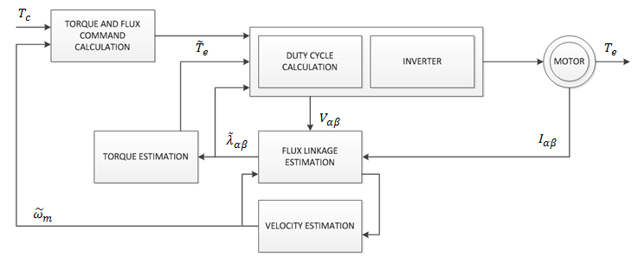
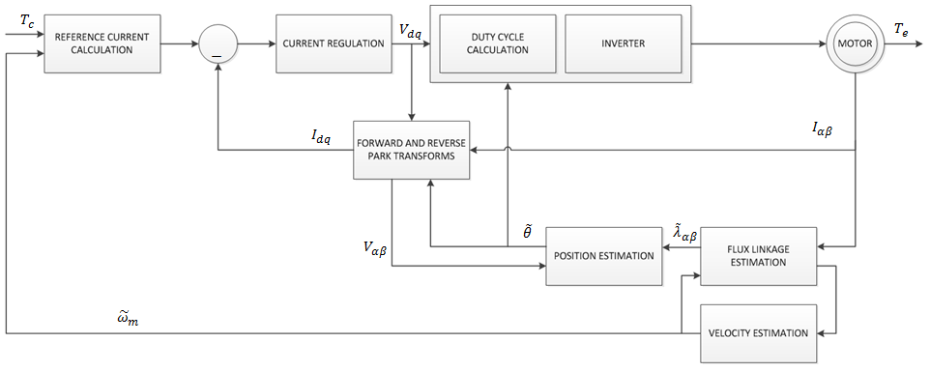
Description of Solution
Flux and velocity estimation in sensorless DTC and FOC systems
Sensorless Direct Torque Control (DTC) System
Sensorless Field Oriented Control (FOC) System

Slide 3
Sliding Mode Observer
Phase shift analysis
LPF
System Discretization (s z)
Miscellaneous (e.g., torque related phase shift)
PLL
v _{sαβ}
i _{sαβ}
Plant Model
Δi _{sαβ}
RP Extraction & Phase Shift Compensation
Sliding Mode Observer
LPF

Slide 4
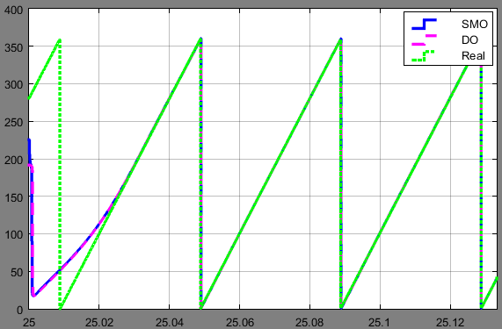
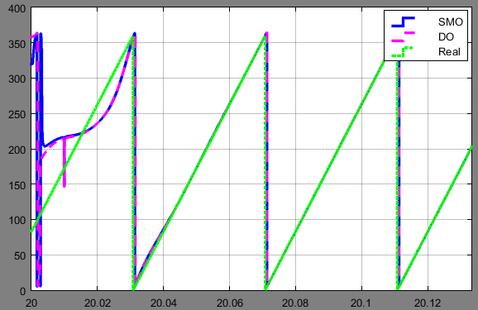
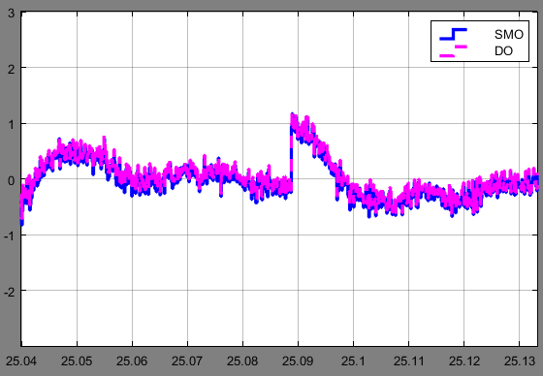
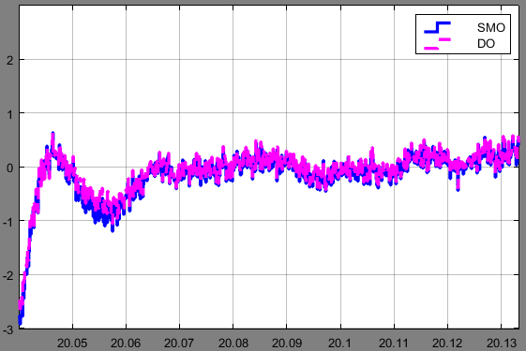
Simulation Results-500 RPM
T_{e} = 0.25 Nm
T_{e} = 2.0 Nm

Slide 5
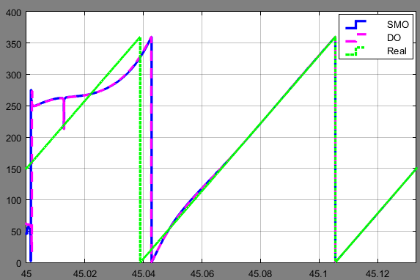
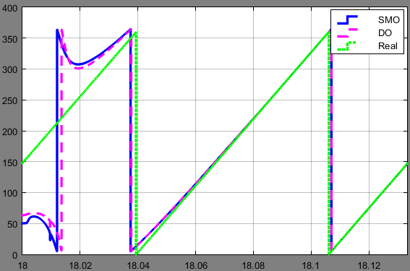
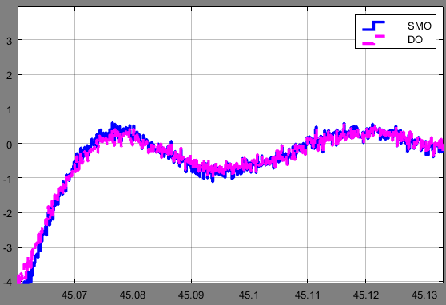
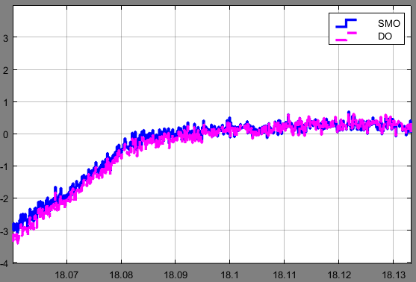
Simulation Results-300 RPM
T_{e} = 0.25 Nm
T_{e} = 2.0 Nm

Slide 6

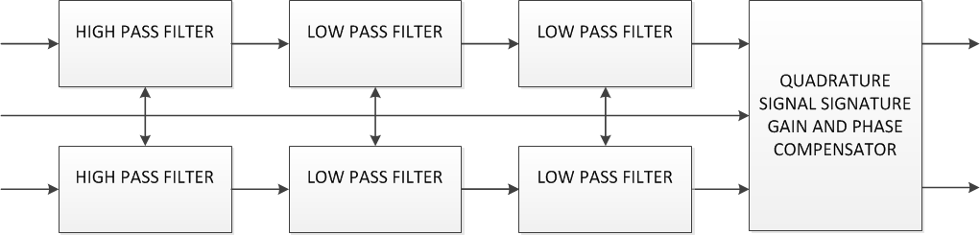












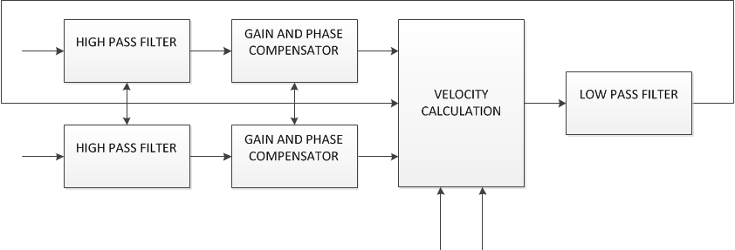











ALGORITHM DETAILS
Flux Estimator Design
Cascaded low-pass and high-pass filters, quadrature signal correction
Bilinear with pre-warping discretization method employed
Open-loop implies actual velocity (instead of estimated velocity) used for flux estimation
Estimated or Actual Velocity
Speed Observer Design
High-pass filter with gain and phase correction for BEMF signals, not implemented
PLL type derivative estimator
$$E_{α}$$
$${\hat{E}}_{α}$$
$$G_{Hv}$$
$$B_{Lv}B_{g}$$
$${\tilde{ω}}_{e}$$
$$E_{β}$$
$${\hat{E}}_{β}$$
$$G_{Hv}$$
$$B_{Lv}B_{g}$$
Cut off frequency 100 Hz
Not implemented in software
$${\tilde{λ}}_{α}$$
$${\tilde{λ}}_{β}$$

Slide 7
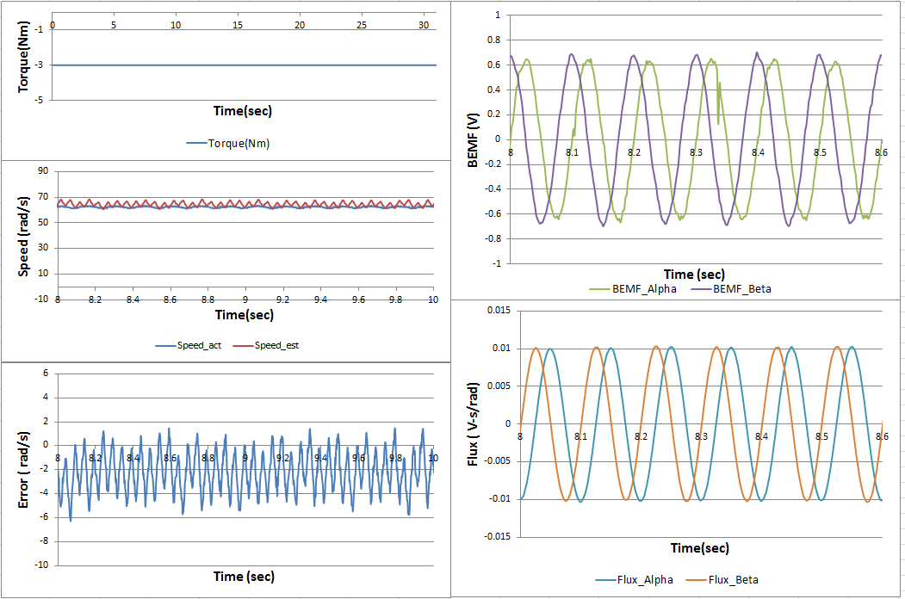
TEST RESULTS
Open-loop, torque 3 Nm, speed 200 RPM (Mech.)

Slide 8
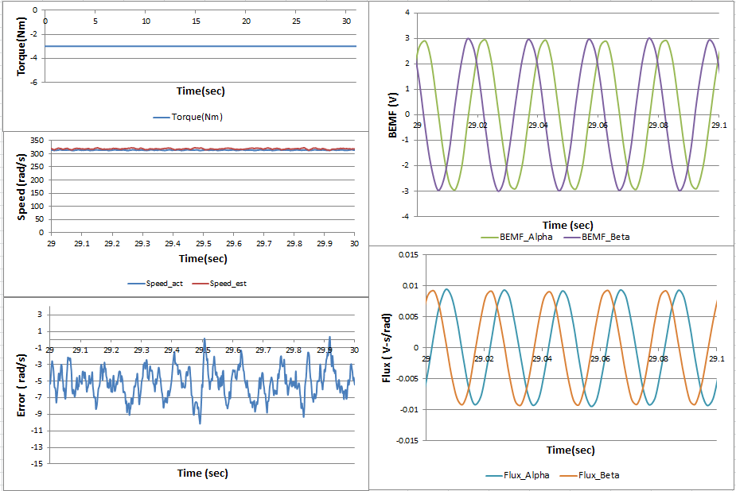
TEST RESULTS
Closed-loop, torque 3 Nm, speed 1000 RPM (Mech.)

